Slide 2
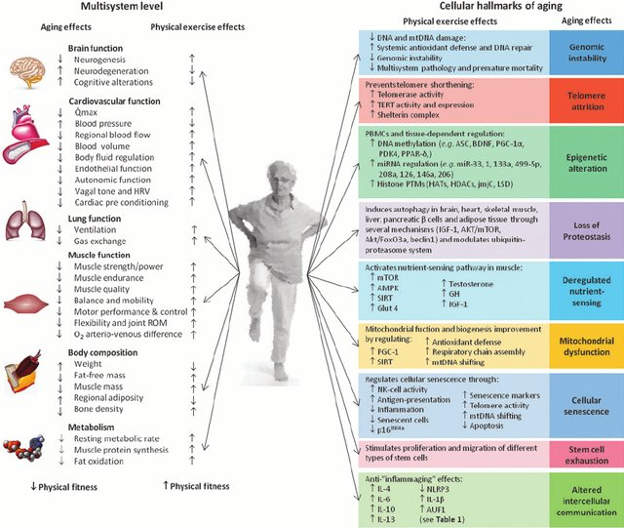

Slide 3
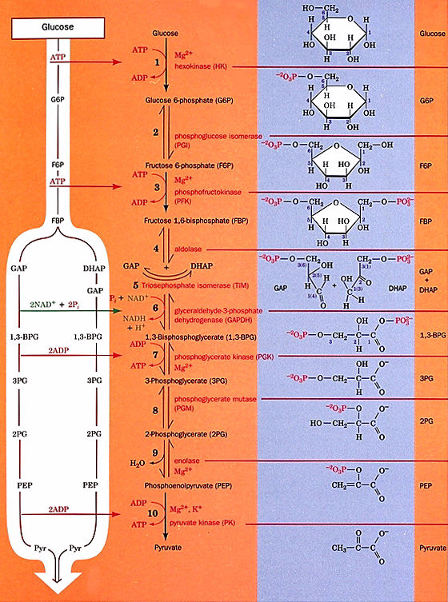

Slide 4
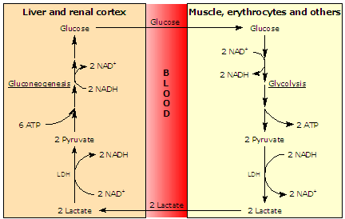

Slide 6
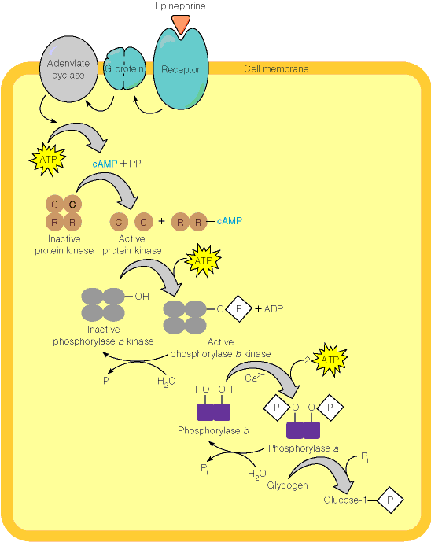
Protein
Kinase A
(AKA
cAMP-
dependent
kinase)
Ca+2
required
for calmodulin,
a subunit of
phosphorylase b

Slide 7
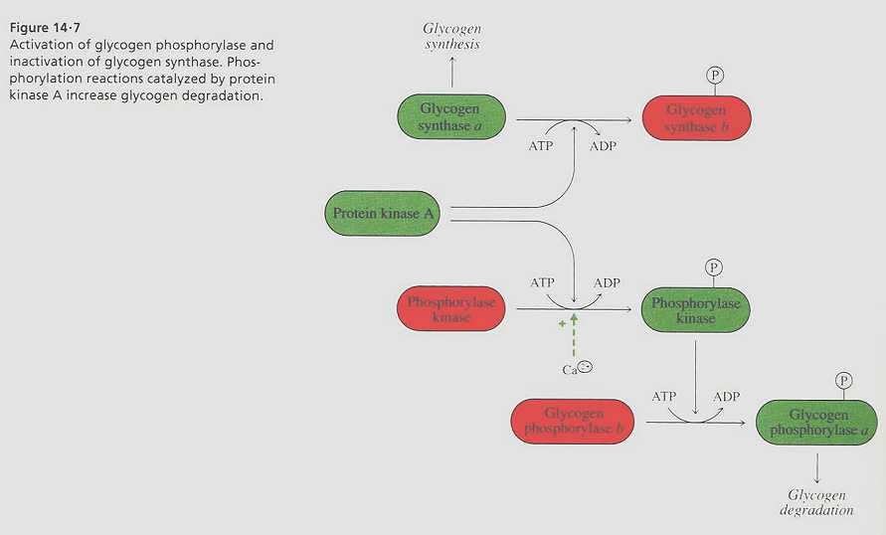
Green=on
Red=off

Slide 8
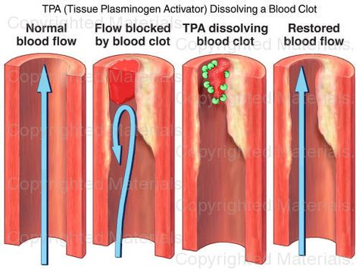

Slide 10
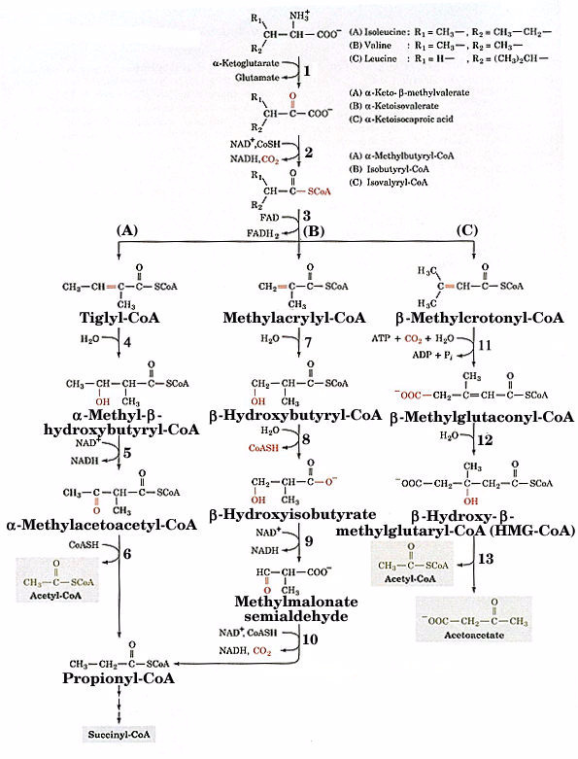
Degradation of branched-
chain amino acids
*
Ile
Val
Leu

Slide 11
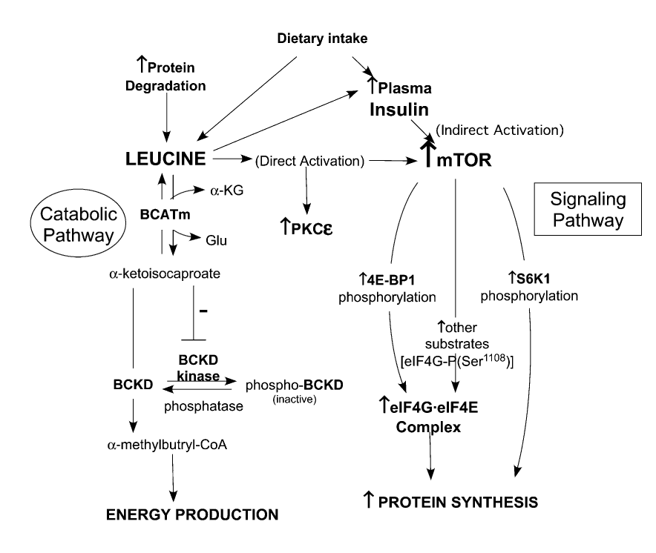
Vary & Lynch, 2007

Slide 12
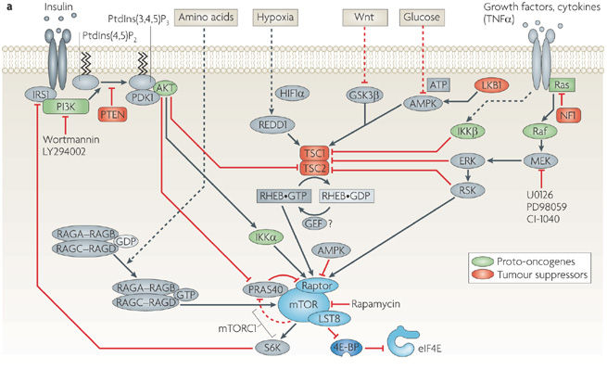
https://www.the-scientist.com/notebook/could-rapamycin-help-humans-live-longer-30021
Xiaoju Max Ma & John Blenis, Nature Reviews Molecular Cell Biology 10, 307-318 (May 2009)
*Raptor: Regulatory-associated protein of mTOR
http://www.ibtimes.com/rapamycin-may-treat-progeria-can-it-slow-natural-aging-295419

Slide 13
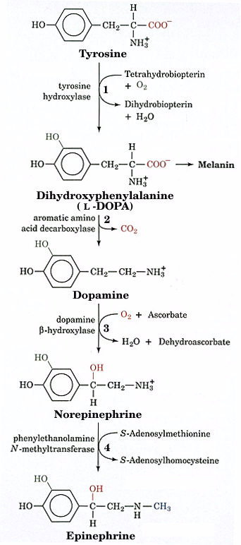
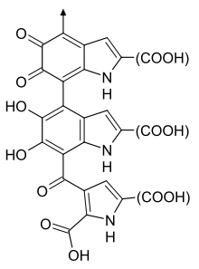
Catecholamine
Synthesis
Melanin

Slide 14
Thyroid hormone synthesis.

Slide 15
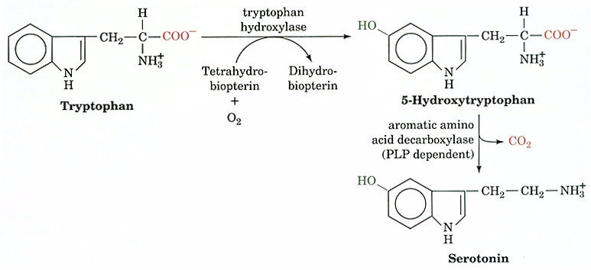
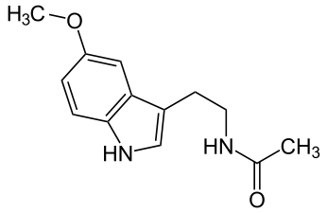
Melatonin

Slide 17
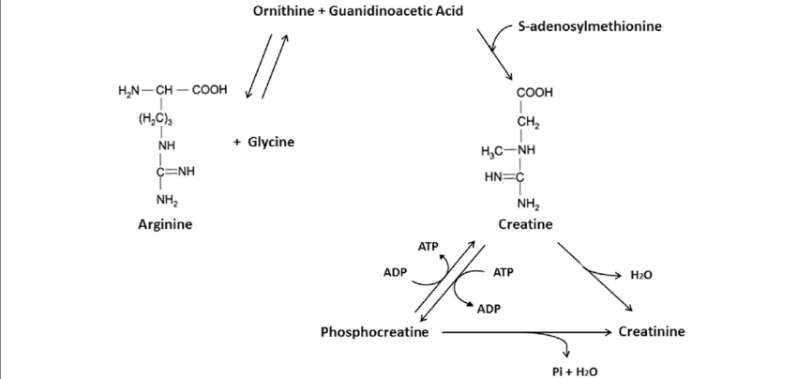
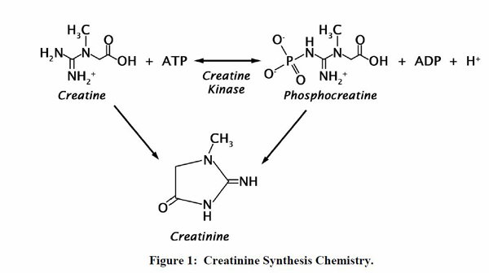

Slide 18
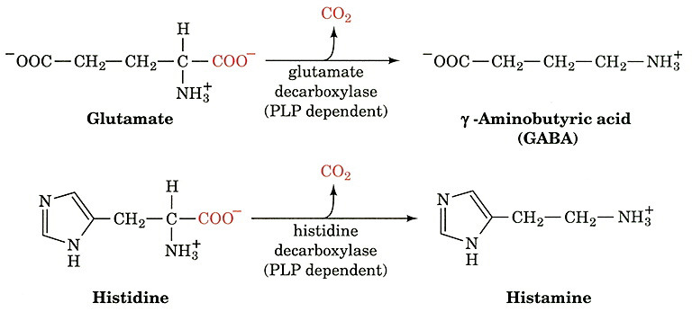

Slide 19
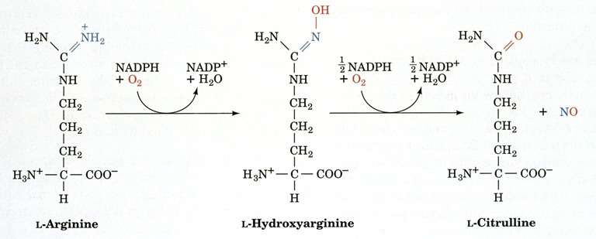
Nitric Oxide Synthase (NOS)

